Slide 1

TheFriendsLook
Jan, Mo, Marvin

Slide 2

Meet new people
Coordinate your free time
fast
Save time
Vision
Get more efficient
easy
Meet friends
User friendly
Have fun

Slide 3

Scope
Vernetzung steigern
Freizeit besser planbar machen
Mehr zeit für freunde
Mehr Spaß
Einfach
Meet new friends

Slide 4

Use Cases
Add/Delete Friends (https://github.com/TheFriendsLook/TheFriendsLook/blob/master/doc/UCadd.md)
Events/Appointments (https://github.com/TheFriendsLook/TheFriendsLook/blob/master/doc/UCappo.md)
Calendar (https://github.com/TheFriendsLook/TheFriendsLook/blob/master/doc/UCcal.md)
Create Account (https://github.com/TheFriendsLook/TheFriendsLook/blob/master/doc/UCcreat.md)

Slide 5

Functionallity
Create events
Discover events
Watch calendar
Subscripe events
Manage your account
(https://github.com/TheFriendsLook/TheFriendsLook/blob/master/doc/SRS.m)

Slide 6

Methodology
Agiles Projektmanagement
Wöchentliche Sprints
Flacher Hierachie
Direkte und offene Kommunikation
Tracking in YouTrack

Slide 7

RUP
Inception
Elaboration
Construction
Transition

Slide 8
RUP
Inception
Elaboration
Construction
Transition

Slide 9
RUP
Inception
Elaboration
Construction
Transition

Slide 10
RUP
Inception
Elaboration
Construction
Transition

Slide 11

YouTrack
Flexibel
Iterativer Prozess
Monitoring
(https://dhbw-karlsruhe.myjetbrains.com/youtrack/dashboard?id=95e71f97-3a1a-4120-916d-a2036778a351)

Slide 12
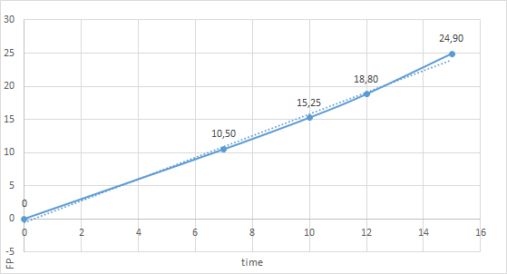
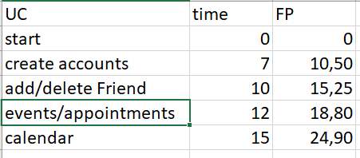
Cost Estimation

Slide 13
Cost real time
server problem
Kein Server -> Keine Nutzer
Keine Zeit für Implementierung

Slide 14
Demo

Slide 15
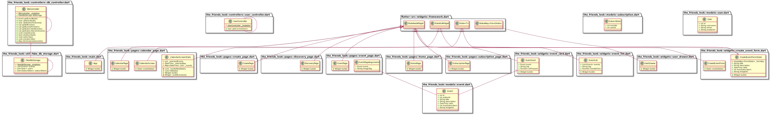
Class Diagram

Slide 16
Class Diagram
https://www.youtube.com/watch?v=FgTSfL13MUA&feature=youtu.be

Slide 17
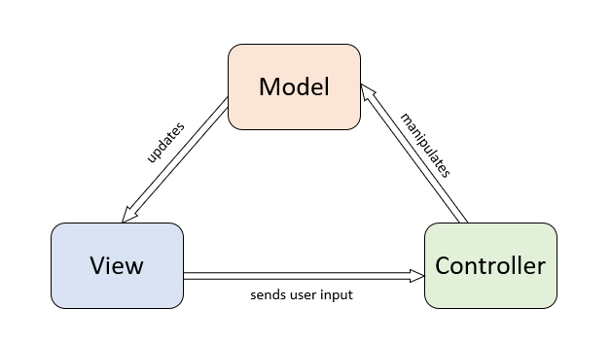
Architecture
Application
Flutter
MVC Modell

Slide 18
Technik
Visual Studio code
Entwicklung
Git
Versionierung
Code Zusammenführung

Slide 19
Technik
Dart Analyzer
Code Analyse
Metrics
Flutter Plugins
DCDG
Klassendiagramme

Slide 20
Automation
Unit Testing
Git
Klassendiagramme erzeugen
SonarQube

Slide 21
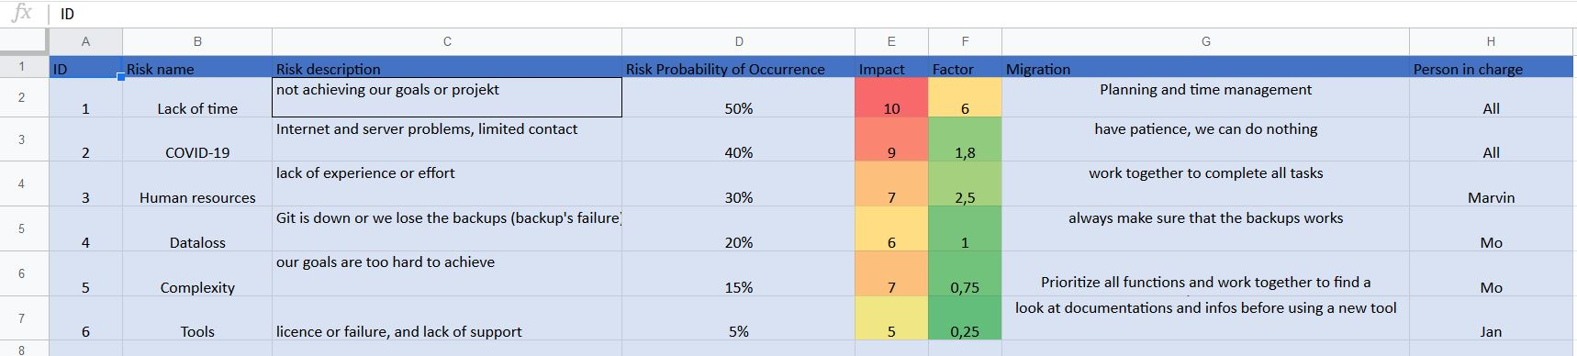
Risk

Slide 22
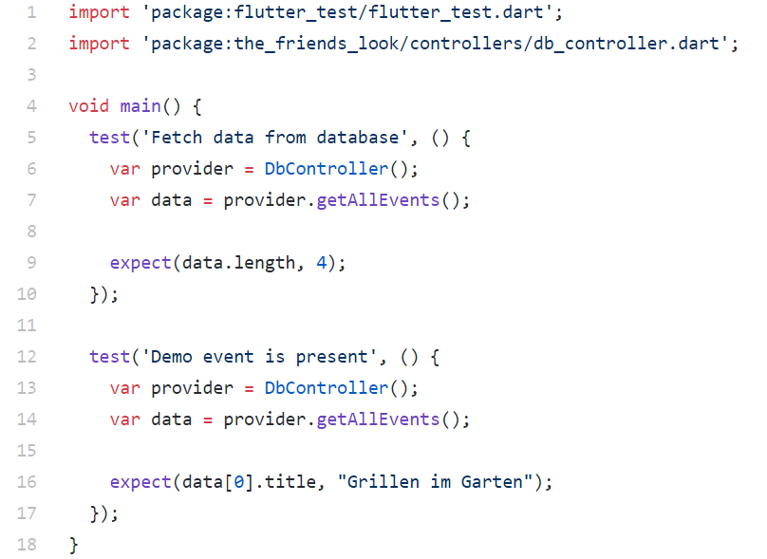
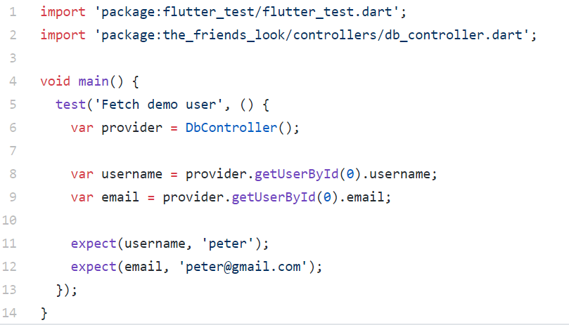
testing
Unit Testing

Slide 23
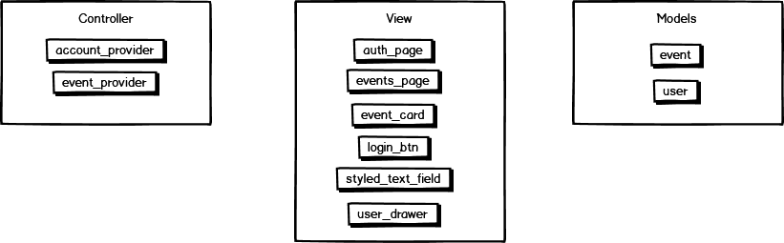
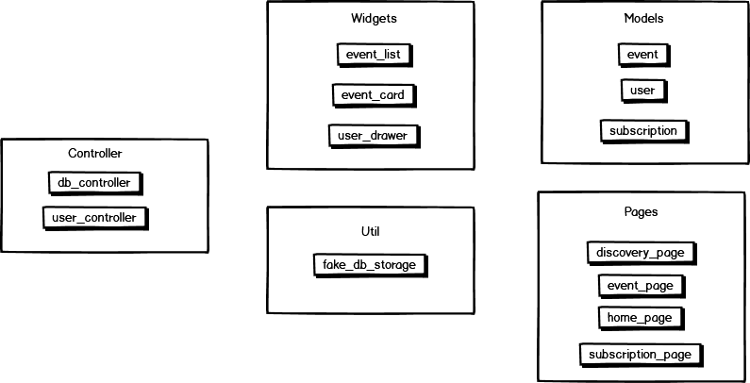
Patterns
before
Sofa Prinzip
Kürzere Methoden
Weniger Argumente
Weniger Abstraktion
Code smells beseitigt
Bessere struktur
after

Slide 24
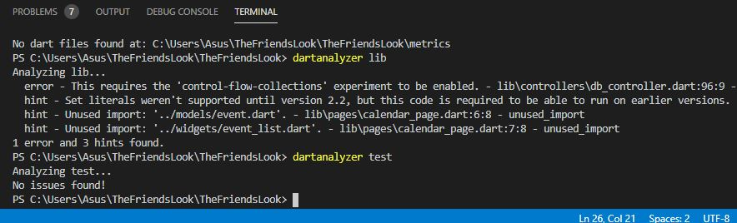
Metrics
Improve Code Quality
Dart Analyzer
Refactore Code

Slide 25
Danke

